Slide 1

CLASSIFICATION WITH TITANIC DATA SET
Burcak Bal Oksuz

Slide 2

Exploration
1) Exploratory Data Analysis
To understand relationship between Features, I did some analysis.
I dropped some columns such as (['Name', 'Ticket', 'Cabin',"Parch"]
I first looked at the correlations with the target data of the columns I wanted to drop.
For example:
correlation = X_train["Parch"].corr(y_train["Survived"])
Correlation
(0,078)

Slide 3
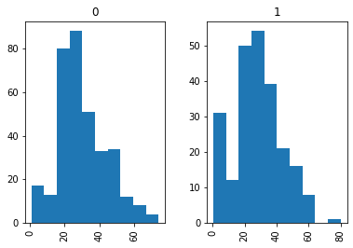
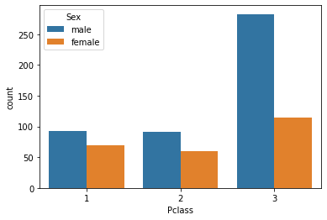
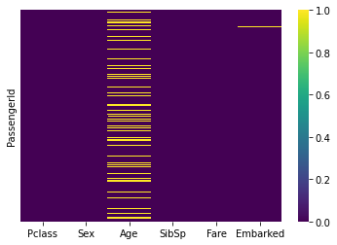
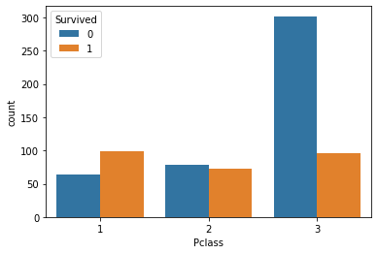
1
2
3
4
Notes:
A histogram showing the age distribution of passengers. Compare surviving/non-surviving passengers.
Create a bar plot with separate bars for male/female passengers and 1st/2nd/3rd class passengers.
Calculate the number of
surviving/non-surviving passengers and display it as a bar plot.
4) In the heatmap graph, we can see the graphs with the msiing values.
Since some columns are strings in the first stage, I could not examine their correlation. For this reason, I dropped these columns, which I thought might be meaningless

Slide 4
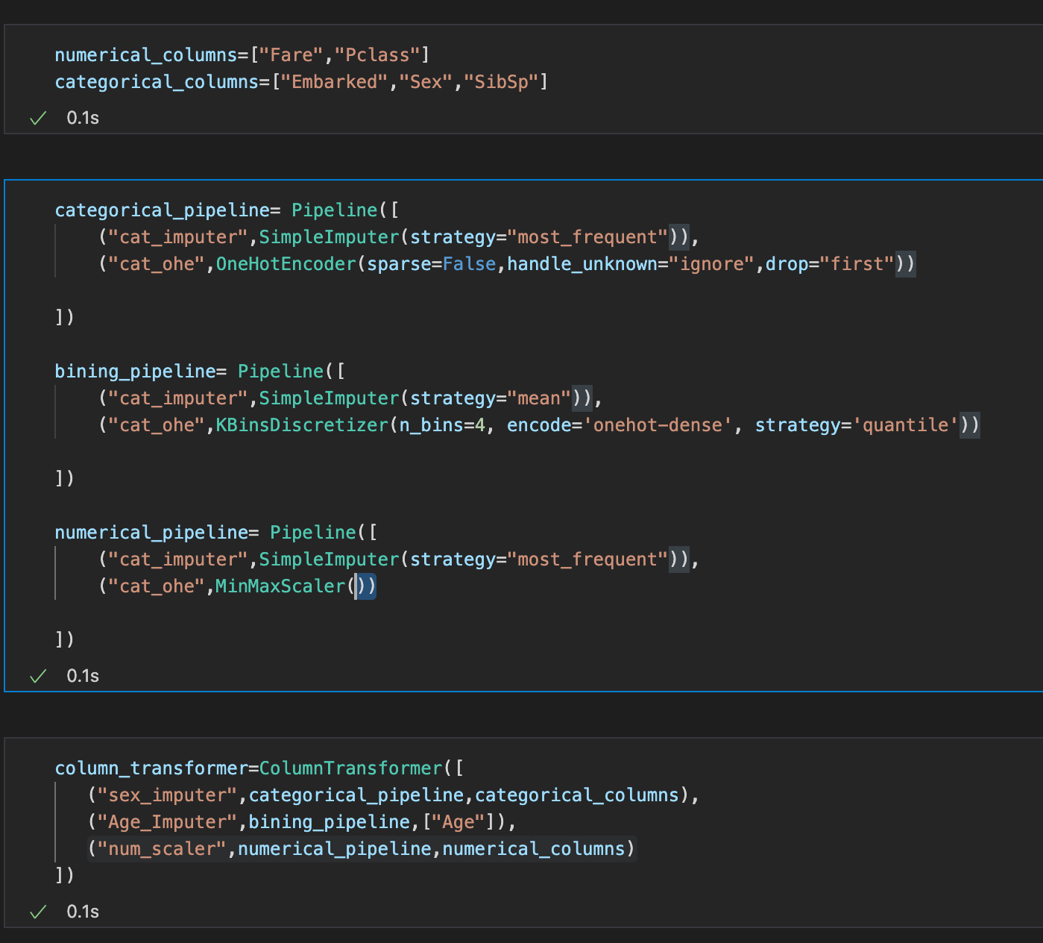
Feature Engineering
Notes:
After determining the numeric and categorical columns in the feature engineering section, I defined a total of 3 pipelines as bining pipeline, numerical and categorical pipelines.

Slide 5
Calculation of train and test accuracy
Model | Train Accuracy | Test Accuracy
Logic Regression | 0.803 | 0.804
Desicion Tree | 0.826 | 0.793
Random Forest | 0.813 | 0.799

Slide 6
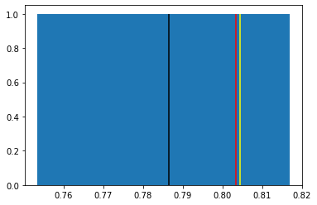

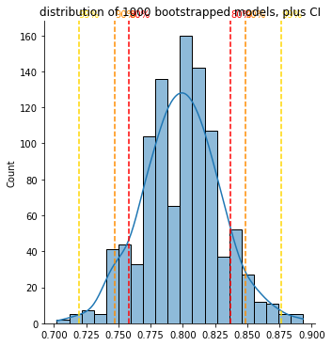
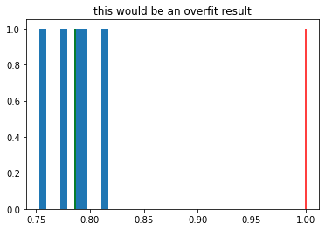
Cross Validation
'Mean cross-validation score: 0.786'
Bootstrapping
%80 confidence:0.758 -0.837
%90 confidence: 0.747- 0.8483
%99 confidence: 0.719 - 0.876
Notes:
As you can see that my traning score and test score are almost same. I think the Model can generalize over the test data.
Green thing is validation score. red is defined as hypotitical case
After bootstrapping process I got this ditrubition of scores. From this graph we can say things about level of confidence.

Slide 7
Decision Tree and Random Forest
Model | Cross Validation Score on Traning Data | Cross Validation Score on Test Data
Desicion Tree (max_depth:5) | 0.789 | 0.704
Desicion Tree (max_depth:4) | 0.7964 | 0.720
Random Forest (max:depth :4) | 0.792 | 0.7764
Notes:
I follow same steps for decision tree and random forest. These are my validation scores for both modelling.
1)Since my model performance on the test data decreases, I need tree prunning process such that the max depth of the tree model is adjusted(5-->4)
2)after this process I got some results.
a)The performance on the test data increased.
b)I prevent over fitting.
c)I lose traning performance but I gained cross validation performance.
In the random forest model I applied same procedure . I continued with max depth as 4 .

Slide 8
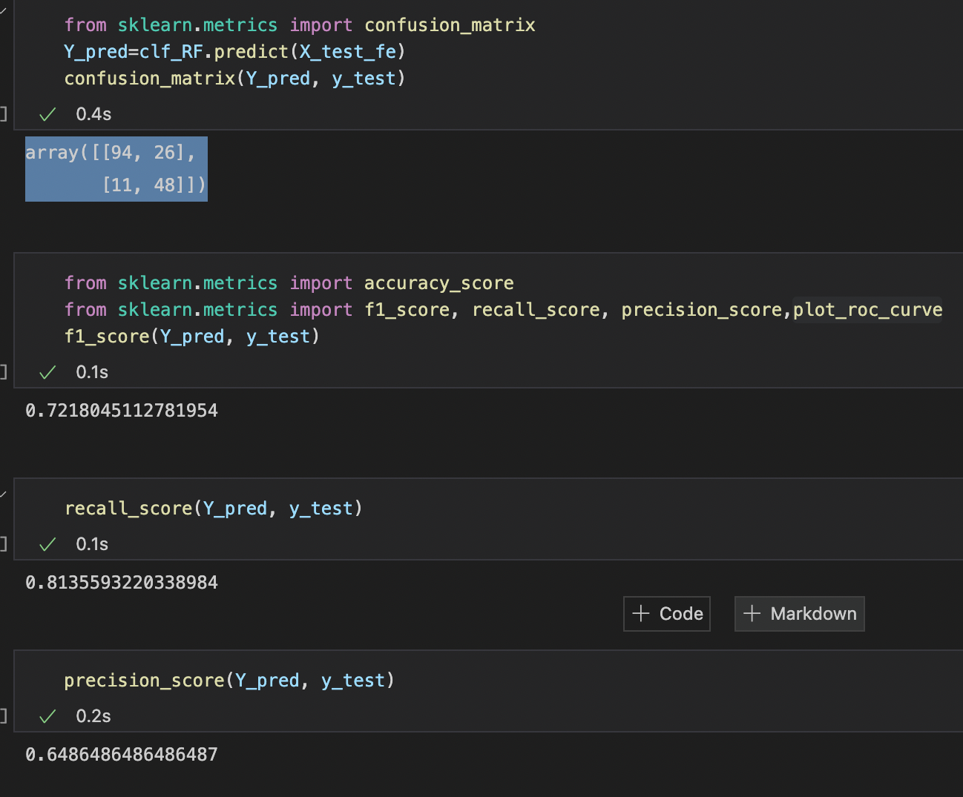
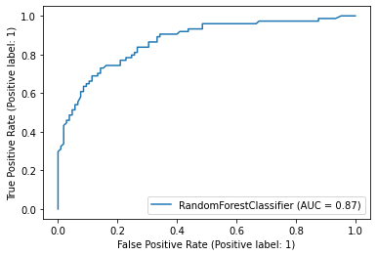
Confusion Matrix,Recall, F1 and Precision Score
Notes:
In addition for Random Forest model I produced some extra scores such as precision, recall, F1 score and confussion matrix.You can see these results here.

Slide 9
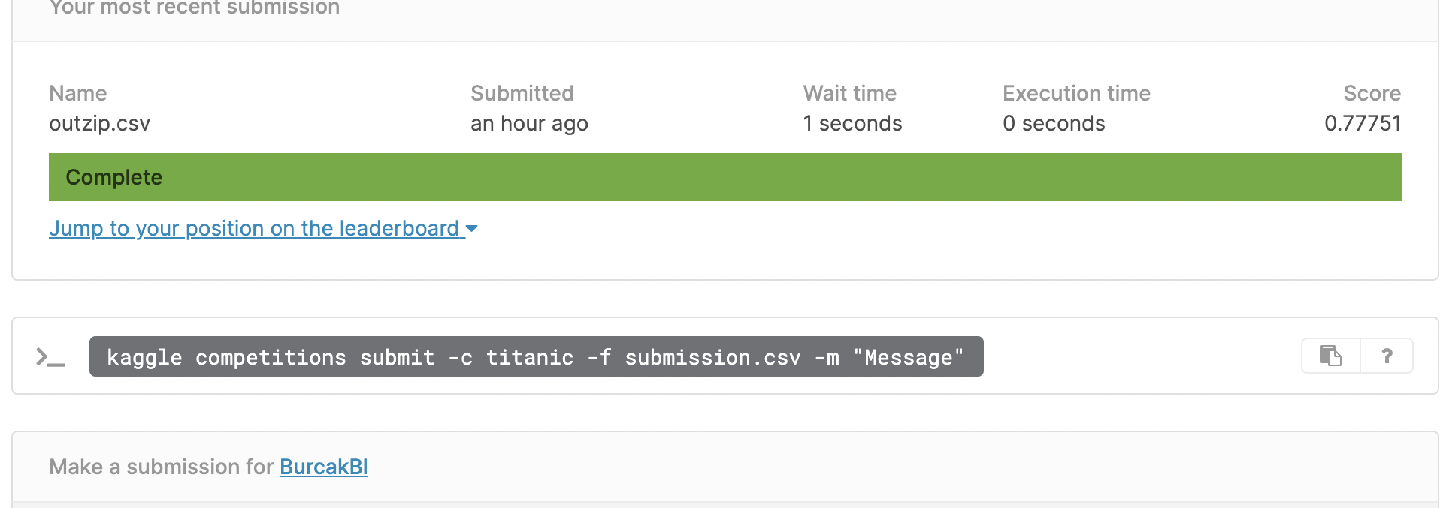
Kaggle Score
Notes:
And Eventually I got this Kaggle Score.

Slide 10

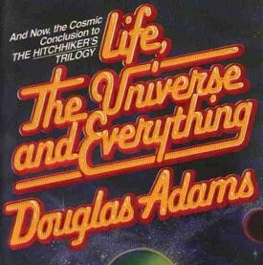

Secret of Random_state=42
Notes:
The number simply has been made popular by a comic science fiction called "The Hitchhiker's Guide to the Galaxy" authored by Douglas Adams in 1978.
In this novel, a supercomputer called Deep Thought takes seven and a half million years to compute the answer to the ultimate question of Life, The Universe and Everything. The answer turns out to be 42. However, the exact question for which it has found the answer is either lost to time or wasn't known in the first place.

